Slide 1
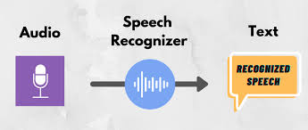
Processing Voice Signals
By
Indian Institute of Information Technology, Nagpur

Slide 2
Timeline
March
Integration of Ensembling Pipeline with Word-level timestamps
Integrating individual components of the pipeline.
January-February
Ensemble Pipeline
Research on multiple fine tuning methods of ASR Models
November-December
Speaker Diarization methods
Post Processing Pipeline
Dataset Preparation(22 hrs)
September-October
Audio Preprocessing(15 days)
Dataset Preparation(40 days)
Survey of Existing ASR and Preprocessing Tools

Slide 3
Process of Speech Recognition
Start when spoken language is captured
Preprocess the digital audio signal
Split preprocess audio signals into small frames
Map each frame to a set of phonemes
Process through a language model
Process the final transcription
Get the final transcribed text or output of the system

Slide 4
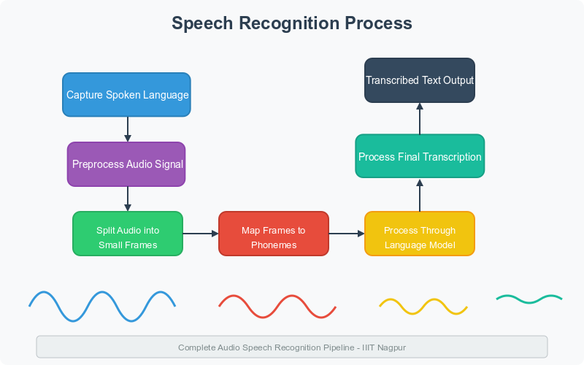

Slide 5
Objectives
Transcript generation in Hindi and English
Labeling
Hindi words in Hindi script and English words in English script
WER of less than 35
Sentiment Analysis
Flagging of dangerous words
Word-level Timestamps
Speaker Diarization

Slide 6
Extraction of Audio files and mono conversion
Resampling Audio files to 16KHz
Splitting of audio files
Audio Preprocessing
Speaker Diarization
Rttm files generated
Timestamp Generation and ASR pipeline
Word Level Timestamp Generation
Ensembling of timestamps
Formation of the final transcription
Post Processing Pipeline with Semantic Analysis
Hallucination Removal
Sentiment Analysis Pipeline
Components in the Pipeline

Slide 7
Audio Preprocessing
A zip file containing audios is considered as an input to the pipeline. The zip file is then extracted and the audio files are preprocessed using the following components:
Conversion to Mono:- Audio was converted to mono channel using ffmpeg library
Resampling:- Then the Audio was Resampled to 16KHz
Splitting:- Then the audio was splitted into 30sec chunks

Slide 8
Speaker Diarization
Complete Audio files were given to the speaker diarization pipeline where we have used pyannote library to extract the time durations for each speaker. The format for the rttm files is as follows:
Type -- segment type; should always by SPEAKER
File ID -- file name; basename of the recording minus extension (e.g., rec1_a)
Channel ID -- channel (1-indexed) that turn is on; should always be 1
Turn Onset -- onset of turn in seconds from beginning of recording
Turn Duration -- duration of turn in seconds
Orthography Field -- should always by < NA >
Speaker Type -- should always be < NA >
Speaker Name -- name of speaker of turn; should be unique within scope of each file
Confidence Score -- system confidence (probability) that information is correct; should always be < NA >
Signal Lookahead Time -- should always be < NA >
Eg: SPEAKER recording_001 1 2.100000 1.200 <NA> <NA> speaker_1 <NA> <NA>

Slide 9
Timestamp Generation
Once the audio chunks are splitted, each chunk is given to the Timestamp generation pipeline where the audio chunks are then transcribed with the word level timestamps. Word level timestamps are stored in the json file and then converted into the csv format.
The csv file format is as follows:
Word | Start time | End time | Confidence Score
Word1 | 3.28 | 3.79 | 94.8421
Word2 | 5.67 | 5.90 | 87.2862

Slide 10
Initial Ensemble Pipeline
In the initial pipeline of Ensemble Learning in ASR Models, we have ensembled the results generated by multiple ASR Models by running them sequentially one after the other. We have designed an algorithm to select the best transcription or the longest un-hallucinated transcription out of the models used. Initially, we have used 5 ASR Models:
Whisper-large-v2
Whisper-hindi-large-v2
Whisper-at
IndicConformer
VoskASR

Slide 11
Current Ensemble Pipeline
The word level timestamps generated by the whisper-timestamped library were then used to ensemble the results based on the higher confidence scores. From the 2 different transcriptions, any 2 words that have a starting time difference of less than or equal to 0.16sec were considered as words spoken on the same time instant.
We have Ensembled the results using the above logic. The final transcription was obtained with accurate word-level timestamps.
Formation of the final Transcription: The final Transcriptions were formed by combining the results generated by Word-level Timestamps and Speaker Diarization.

Slide 12
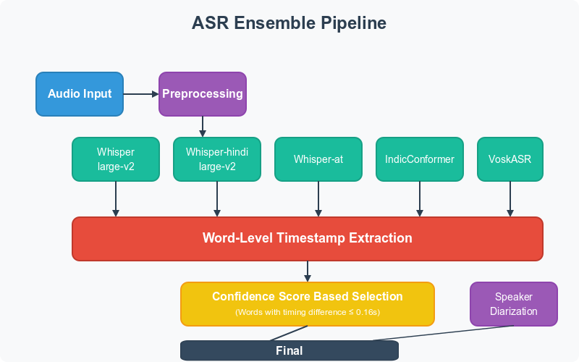

Slide 13
Final Transcription Format
The final format of Transcription is a combination of 3 different outputs: Transcriptions, Word level Timestamps and Speaker Diarization.
Transcription: नमस्ते! आप कैसे हैं? मैं ठीक हूँ।
Word, Start Time (s), End Time (s), Confidence Score
नमस्ते, 2.10, 2.50, 95.34
आप, 2.51, 2.75, 98.28
कैसे, 2.76, 3.10, 92.84
हैं, 3.11, 3.30, 97.56
मैं, 4.50, 4.75, 93.76
ठीक, 4.76, 5.10, 96.84
हूँ, 5.11, 5.30, 94.57
SPEAKER recording_001 1 2.100000 1.200 <NA> <NA> speaker_1 <NA> <NA>
SPEAKER recording_001 1 4.500000 0.800 <NA> <NA> speaker_2 <NA> <NA>

Slide 14
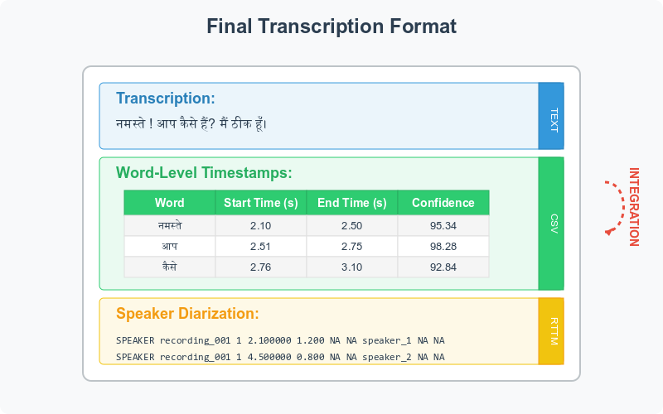

Slide 15
Post Processing Pipeline
Hallucination Removal
Any string containing 1 to 5 words that is repeated more than 7 times is considered as Hallucinations and are removed with the same logic.
Sentiment Analysis
Sentiment Classification
Determines the overall emotional tone of a text. Distributed into 3 categories i.e. Positive, Negative and Neutral.
Categorizes sentiment into user-defined labels beyond standard ones. For eg: Dangerous, Threatening, Toxic, Abnormal, etc.
Confidence Scores
Explanation with Keywords
Named Entity Recognition
Measures how certain the model is about its prediction. It is generally a number ranging from 0 to 1.
Explains the content and Highlights key terms that influenced the sentiment decision.
Identifies and classifies entities like names, places, and organizations in text.

Slide 16
Sentiment and Semantic Analysis Pipeline
To generate the results of the Sentiment Analysis pipeline, we have downloaded LLMs such as Llama3.1, qwen2.5, mistral, claude and used them in the pipeline to generate results by invoking Ollama. The results generated for each complete transcriptions were stored in the form of a table.
After the complete processing, the final transcriptions and Sentiment Analysis were stored in the output directories where each separate text files were generated for each separate Transcription displaying Transcription, Word-level Timestamps, Speaker Diarization data and and another file for complete Sentiment Analysis report with the json log file.

Slide 17
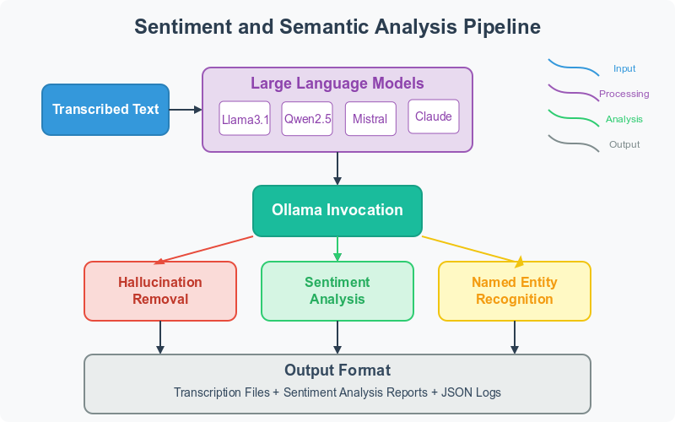

Slide 18
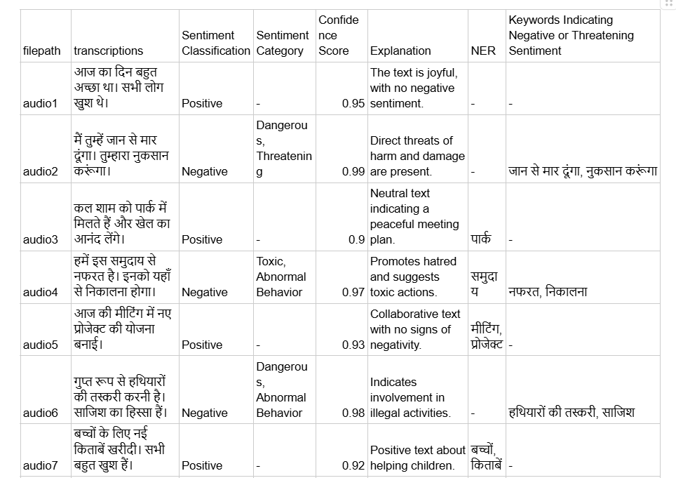

Slide 19
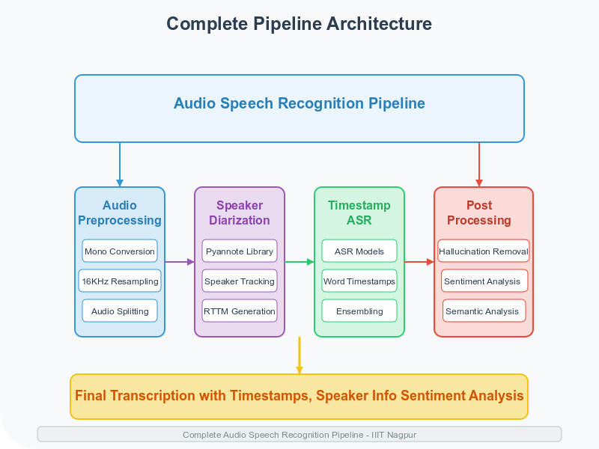

Slide 20
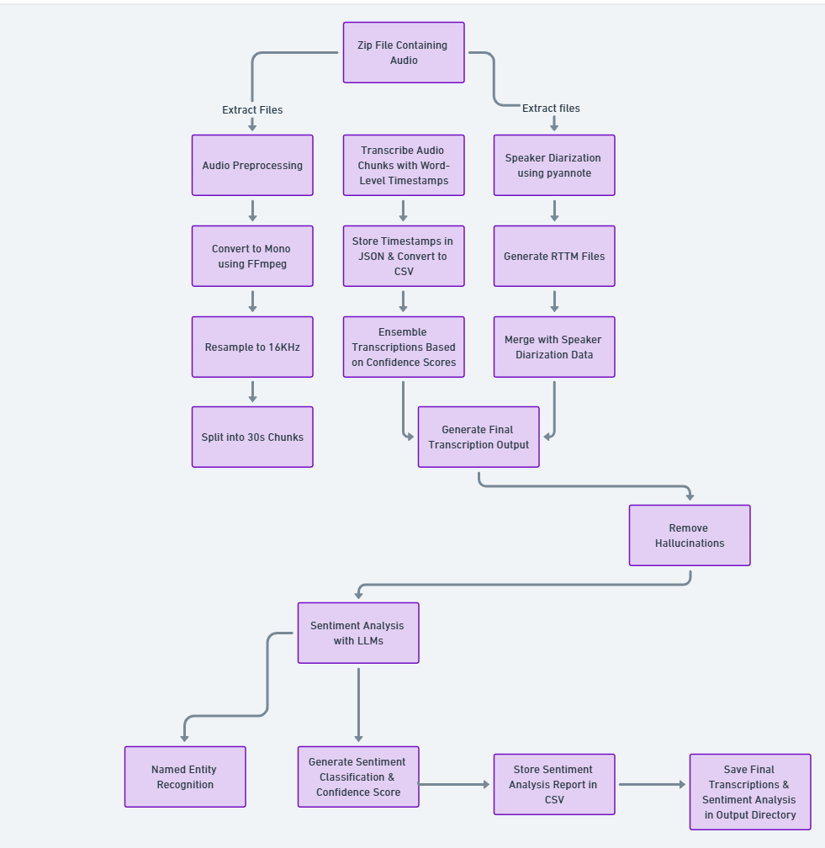

Slide 21
Fine Tuning Results of Whisper Model
Initially the wer for whisper-large-v2 model was 80-85 %
After fine-tuning with 100 hours dataset(by gram-vaani) wer was 65-70 %.
And Today we fine-tuned with 462 hours dataset( 460 hours open-source + 2 hours manual labelled) wer decreased to 54 %.
Then we fine tuned the model on a bulk dataset of 3800hrs containing 9hrs of manually transcribed data. The wer obtained was 52%.
Whisper-large-v2 was fine tuned on (22 hrs manually trascribed+108 hrs of Gramvaani Dataset) and the wer obtained was 120-130%.

Slide 22
Word Error Rate Analysis of the pipeline
A = Pre Trained Whisper large v2
B = Fine Tuned Whisper Large v2
C = Token-updated-whisper-hindi-large-v2
D = Bhashini
Combination of models on different datasets | 95 test samples | UKG & ML Dataset(49 samples) | Hindi_Data_1 (330 samples) | Hindi_Data_1 (565 samples)
A+C | 47.21 | 35.09 | 33.81 | 35.31
A+D | 31.38 | 33.95 | - | -
B+D | - | 33.95 | - | -

Slide 23
Outcome of the Project
Being a part of this project was a great experience. Through the journey of the complete project:
Though we have a significant achievement in WER, Improving the WER was the most challenging task throughout the project.
Noise Reduction was also a very complex and difficult task when the frequencies of the noise and the voice were in the same range.
We have assembled the complete End-to-End pipeline which is completely automated and generates transcriptions, word-level timestamps, Speaker-diarization in a single file and the complete Sentiment Analysis Report in another file.
We have also used a complete different method known as Ensemble Learning where we use multiple ASR Models to generate a combined quality transcription.

Slide 24
What we have Learnt
Working on this grand project was a really great experience for us on such an initial stage of life.
We have learnt how to use Virtual Machines as well as run large LLMs and ASR Models and great amount of GPUs.
We have also got first-hand experience in fine tuning large ASR Models and we tried multiple different scripts to finetune models like Whisper-large-v2, Whisper-hindi-large-v2 and IndicConformer.
We have also tested a lot of different ASR Models in the ASR survey phase of the project and later on as well.
We also did a lot of Research on reducing the WER through a lot of different Methods.

Slide 25
ASR Models Tested
Whisper-large-v2
Whisper-hindi-large-v2
Bhashini & Vashistha
IndicConformer
Indic-Hybrid
Whisper-large-v3 and large-v3 Turbo
Whisper-C++
Crispr-Whisper
Whisperx & Whisper-jax
Vosk-ASR
Whisper-at
Whisper_distillation

Slide 26
Sentiment Analysis Models Tested
1. General Multilingual ASR Models
Bert-base-multilingual-cased
XLM-RoBERTa-base
2. Indian Language-Specific ASR Models
AI4Bharat/Indic-BERT
IndicBART
Airavata
3. Toxic or Dangerous Language Classification Models
Unitary/Toxic-BERT
4. Named Entity Recognition (NER) Models
IndicNER
dslim/BERT-large-NER
5. NER Datasets
Naamapadam

Slide 27
Noise Reduction Methods
1. Conventional Techniques that we used:
  Spectral Grating using FFT( Fast-fourier-Transform).
  Spectral Grating using STFT( Short-time-fourier-Transform).
  Spectral Subtraction
  VAD + NMF
  VAD + Median Avg. Filter
  VAD + Wiener Filter
  VAD + Kalman Filter

Slide 28
2. Non Conventional Techniques: Algorithms and Deep Learning Models for Noise Removal
Whisper-at:- Gave mixed results but certainly helped for transcribing audio files with noise.
DeepFilterNet:- Advanced Deep Learning algorithms and AI models used for speaker voice enhancement and noise segregation. Worked very well for noisy files and gave better results when AudioSR was used before DeepFilterNet. Can also be used individually.
AudioSR:- Audio Speech Recognition separates components of audio such as voice, noise, instruments, etc.
5. Other Models tried and tested:
RNNoise: RNNoise is an RNN used for real time audio noise suppression.
Speech-Denoiser: Can Denoise speech without clean data using Noise2Noise Approach
Speech Brain Models: Provide a list of models for denoising tasks: WavLM, Dual Path RNNs, SSE, etc

Slide 29
a. Selective Band-Pass Filters:- Frequency band-pass filters were applied dynamically depending upon the average and effective frequency range.
b. Pitch based Filtering:- Speaker Diarization using Pyannote library was performed in order to separate the different pitches present in the audio files and thus the pitches lying in the range of human voice were retained whereas the rest of them were nullified.
c. Frequency based Filtering:- A similar approach to the pitch based filtering but this time the diarization was performed based on Frequencies.
For the Noise Reduction, we have used a combination of all the three techniques mentioned above. The Pitch based filtering alone performed very well.
Unlike Deep Learning Models, these technique does not increase hallucinations.

Slide 30
Archives of Significant Research Work Done
Designing different fine tuning scripts from scratch for multiple ASR Models: Transfer Learning and Distillation methods
Research on Noise Reduction
Whisper-prompting in Air-Traffic Controller Systems
Updating Tokenizers of multiple ASR Models
Data Augmentation
Effect of change of speed, Amplitude, frequency and pitch on Audio Quality and Transcription Quality.
Noise Reduction

Slide 31
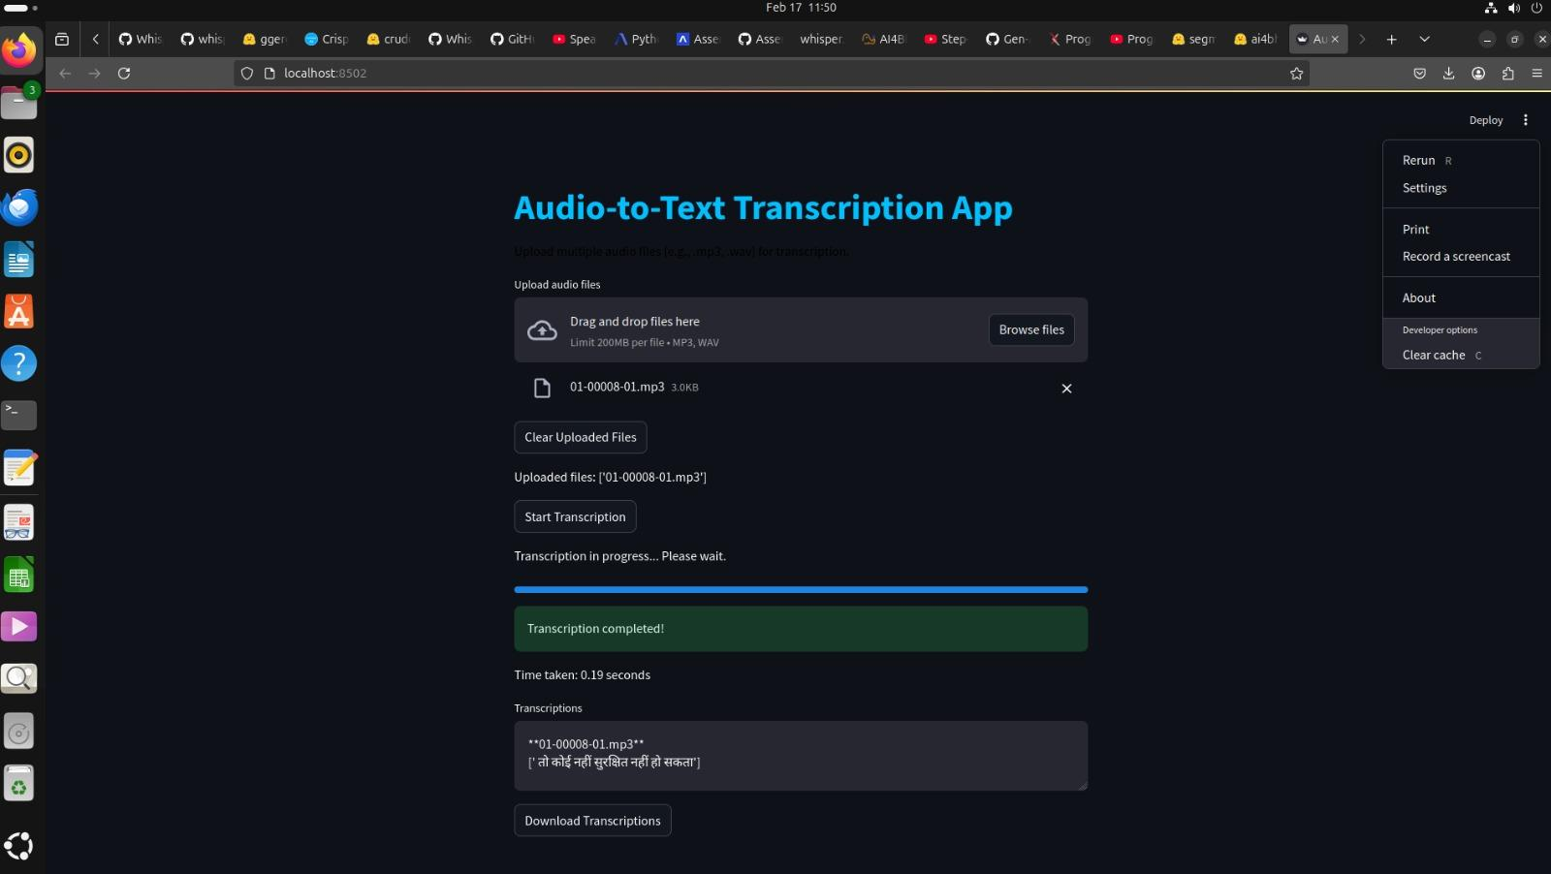
Developed a Small GUI-Transcription Result only

Slide 32
Key achievements
WER in the range of 30-35 was obtained
A very unique method of Ensemble Learning was successfully tried out in the ASR pipeline to generate quality transcriptions
Sentiment Analysis is successfully generated using significant LLMs which contains Sentiment Categorization, classification with confidence scores, NER, Keywords, Content flagging,etc.
Word-level timestamps have been successfully generated with very good accuracy.
Hallucinations were removed upto a significant extent(around 90%) through post-processing of Transcriptions

Slide 33
Conclusion
We successfully built an advanced ASR pipeline integrating speech-to-text, sentiment analysis, and keyword flagging, achieving a competitive WER of 30-35%. Our system includes word-level timestamps, speaker diarization, and multilingual support, ensuring accurate and context-aware transcriptions. Extensive research and experimentation with fine-tuning scripts enabled model optimizations for Hindi and other languages. This project demonstrates a scalable, AI-driven transcription framework capable of handling complex linguistic and acoustic challenges.

Slide 34


